Slide 1


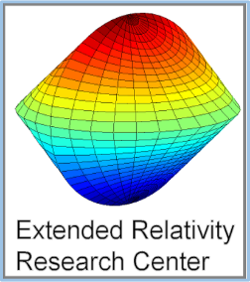
Relativistic Gravitation of a Spherically Symmetric Body
Using symmetry and Euler-Lagrange equations to calculate
planet precession, gravitational time dilation and light deflection.
Created by Josh Sol using prof Yaakov Friedman’s lectures with the help of the Jerusalem College of Technology
and the Extended Relativity Research Center

Slide 2
CONTENTS
General relativity
Motivation for geodesic motion
Euler-Lagrange equations
Bipolar coordinates
The implications of symmetry for the metric
Newtonian limit
Evolution equation
Solving the equation of motion for a massive object
Precession of Mercury
Solving the equation of motion for light
Deflection of light
Gravitational time dilation
Energy conservation
Appendix

Slide 3
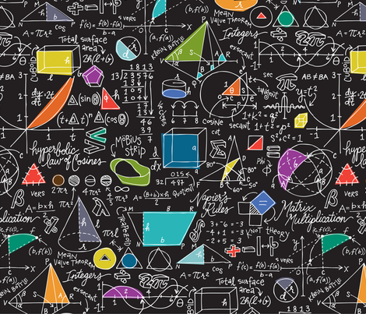
INTRODUCTION

Slide 4
GENERAL RELATIVITY (GR)
Einstein’s GR assumes:
  the gravitational force curves spacetime and the curvature is expressed by a metric.
  the motion of any object, massive or massless, is by a geodesic with respect to this metric
The metric is defined from the sources of the field by Einstein’s field equations - a set of nonlinear, partial differential equations
Even in simple cases, the calculation of the trajectory is complicated

Slide 5
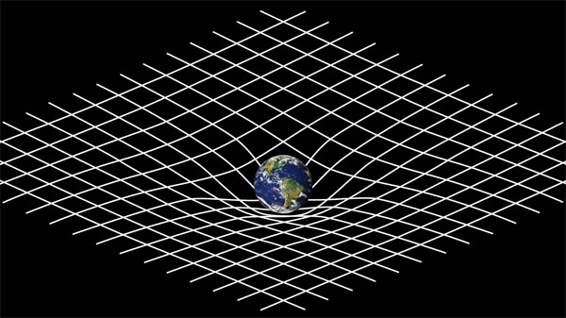
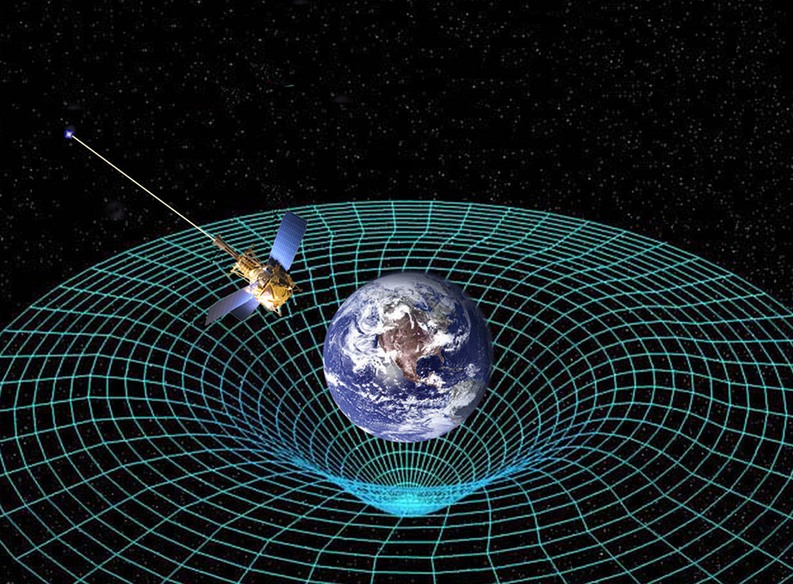
GENERAL RELATIVITY (GR)
VISUALIZATION OF CURVED SPACE-TIME

Slide 6
RELATIVISTIC GRAVITATION (RG)
As in GR, we assume that in a gravitational field, objects move by a geodesic with respect to a metric defined by the field.
The metric for a spherically symmetric body is defined on flat spacetime and is derived using only:
  symmetry
  the fact that the field propagates with the speed of light
  the Newtonian limit

Slide 7
MOTIVATION FOR GEODESIC MOTION
Motion of a physical object is influenced only by the surrounding force fields that affect it.
The uniqueness of a gravitational field is that it affects all bodies equally and its influence is expressed by a metric on flat spacetime.
Since an inanimate object is unable to change its velocity, it will move uniformly (constant velocity, zero acceleration or shortest route) in the influenced spacetime when not disturbed by other objects.
The shortest route motion with respect to a metric is called geodesic motion.

Slide 8

EULER-LAGRANGE EQUATIONS
FOR
GEODESICS
Line interval on flat background
$ds^{2}=g_{αβ}dx^{α}dx^{β}$ (1)
The Lagrangian is:
$L\left(x,\dot{x}\right)=c\frac{ds}{dσ}=c\sqrt{g_{αβ}{\dot{x}}^{α}{\dot{x}}^{β}}$ (2)
Euler-Lagrange equation:
$\frac{∂L}{∂x^{α}}−\frac{d}{dσ}\frac{∂L}{∂{\dot{x}}^{α}}=0$ (3)
$\frac{∂L}{∂{\dot{x}}^{α}}=\frac{c2g_{αβ}{\dot{x}}^{β}}{2⋅\frac{ds}{dσ}}=c⋅g_{αβ}\left(\frac{dx^{β}}{ds}\right)=c⋅{\left(\frac{∂x}{∂s}\right)}_{α}$ (4.1)
$\frac{∂L}{∂x^{μ}}=\frac{1}{2}\frac{∂}{∂x^{μ}}\left(g_{αβ}\right){\dot{x}}^{α}{\dot{x}}^{β}$ (4.2)
Proper time:
$ds=cdτ\text{, } {\dot{x}}^{α}=\frac{dx^{α}}{dτ}$ (5.1, 5.2)
If so, $c⋅{\left(\frac{∂x}{∂s}\right)}_{α}={\left(\frac{∂x}{∂τ}\right)}_{α} ⟹ \frac{d}{dτ}{\left(\frac{∂x}{∂τ}\right)}_{μ}=a_{μ}$
Equation of motion:
$a_{μ}=\frac{1}{2}\frac{∂}{∂x^{μ}}\left(g_{αβ}\right){\dot{x}}^{α}{\dot{x}}^{β}$ (Acceleration) (6)

Slide 9
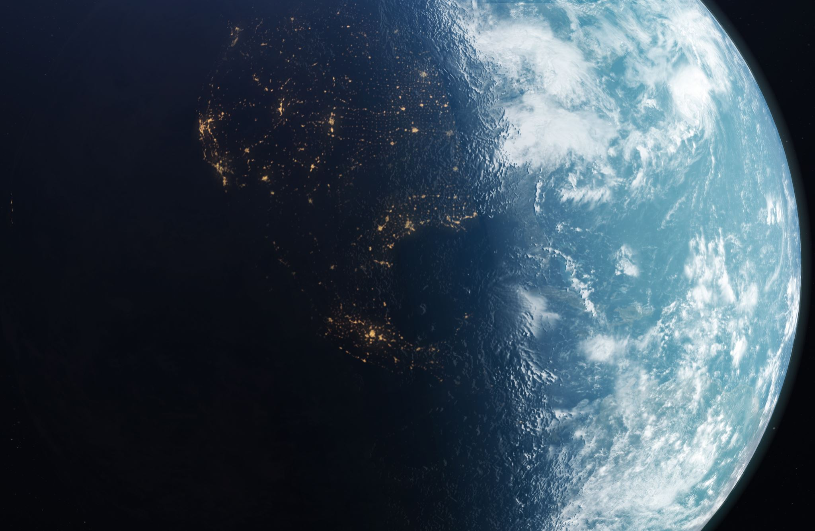
GRAVITATIONAL FIELD OUTSIDE A SPHERICALLY SYMMETRIC SOURCE

Slide 10

BIPOLAR COORDINATES
Use bipolar coordinates $\left(ρ^{0}, ρ^{1}, φ, θ\right)$ on Minkowski spacetime $M$with the center at the center of the source:
$r^{0}=ρ^{0}\cosh{θ}$ (7.1)
$r^{1}=ρ^{1}cosφ$ (7.2)
$r^{2}=ρ^{1} sinφ$ (7.3)
$r^{3}=ρ^{0}\sinh{θ}$ (7.4)
The trajectory of motion of an object in the field is in a 2D plane $Π$defined by its initial position and its initial velocity, since the force vector acting on $P$ is also in $Π$.
We rotate the coordinates to make $Π$the $\left\{r^{1},r^{2}\right\}$ plane, or
$r^{3}=0$ and $θ=0$ (from now on we will ignore $r^{3}$)
The retarded position is a null vector
$$\left(ρ^{0}=ρ^{1}=ρ\right) , y=(ρ,ρ, φ)$$

Slide 11
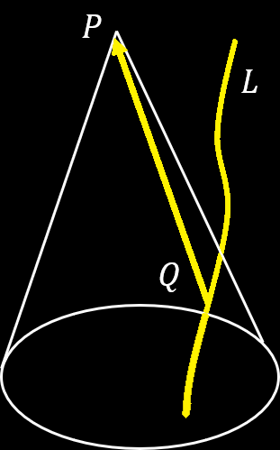

FIELD GENERATED BY A SINGLE SOURCE
To describe the field at a spacetime point $P$
$L$ is the world-line of the source of the field
The retarded position $Q$ is the intersection of $L$ with the past light-cone with vertex at $P$
Assuming the field propagates with the speed of light, the field strengthat $P$ depends only on the strength of the source at $Q$
The direction of influence vector $\vec{QP }$ is a future-pointing null vector

Slide 12

THE METRIC OF A SPHERICALLY SYMMETRIC SOURCE IN BIPOLAR COORDINATES
Relative position
$y=\left(r,r, φ\right)=r\left(1,1, φ\right)=r\hat{y}$ (8)
in bipolar coordinates.
${\hat{y}}_{α}$ is the direction of influence which is also the direction of field propagation
Form of RG metric:
$g_{αβ}=η_{αβ}−φ\left(r\right){\hat{y}}_{α}{\hat{y}}_{β}$ (9)
$η_{αβ}$ is the Minkowski metric.
We use the local basis $d$
$d_{0}=\left(1,0,0\right), d_{1}=(0, \cos{φ},\sin{φ)}, d_{2}=(0,−\sin{φ,\cos{φ}) }$
In this basis, $\hat{y}=\left(1,1,0\right)$
$η_{αβ}=\left(\begin{matrix}1 & 0 & 0 \\ 0 & −1 & 0 \\ 0 & 0 & −1\end{matrix}\right)$ (10.1)
$⟹ g_{αβ}=\left(\begin{matrix}1−φ & −φ & 0 \\ −φ & −1−φ & 0 \\ 0 & 0 & −1\end{matrix}\right)$ (10.2)

Slide 13

RG DYNAMICS EQUATION OF MOTION
From Euler-Lagrange equations (6), $a_{μ}=\frac{1}{2}\frac{∂}{∂x^{μ}}\left(g_{αβ}\right){\dot{x}}^{α}{\dot{x}}^{β}$
$x=ct⋅d_{0}+r⋅d_{1}$
$⇒ \dot{x}=c\dot{t}⋅d_{0}+\dot{r}⋅d_{1}+r\dot{d_{1}}$ $=c\dot{t}⋅d_{0}+\dot{r}⋅d_{1}+r\dot{φ}⋅d_{2}= \left(c\dot{t}, \dot{r},r\dot{φ}\right)$
where $\dot{r}$is the radial velocity and $r\dot{φ}$ is the transverse velocity
Since $\hat{y}=(1,1,0)$, ${\hat{y}}_{α}{\dot{x}}^{α}=c\dot{t}+\dot{r}$
Since $g_{αβ}$ depends only on $r$, the only non-zero acceleration is $a_{1}$
Using equations (6) and (9),
$a_{1}=−\frac{1}{2}φ^{′}\left(r\right){\hat{y}}_{α}{\hat{y}}_{β}{\dot{x}}^{α}{\dot{x}}^{β}=−\frac{1}{2}φ^{′}\left(r\right){\left(c\dot{t}+\dot{r}\right)}^{2}$ (11.1)
Since $\dot{r}=\dot{t}v_{r},$
$a_{1}=−\frac{1}{2}φ′\left(r\right){c^{2}{\dot{t}}^{2}\left(1+\frac{v_{r}}{c}\right)}^{2}$ (11.2)

Slide 14

THE NEWTONIAN LIMIT
Newtonian limit:
Acceleration of any object $O$ with zero initial velocity is classical
For $O:$ $v_{r}=0, a_{1}≡−\frac{d^{2}r}{dτ^{2}}=−\left(\frac{d}{dτ}\left(\frac{dt}{dτ}⋅\frac{dr}{dt}\right)+{\left(\frac{dt}{dτ}\right)}^{2}⋅\frac{d^{2}r}{dt^{2}}\right)$
for Newtonian limit $\left(\frac{dr}{dt}\right)=0 ⟹a_{1} ={\left(\frac{dt}{dτ}\right)}^{2}⋅\frac{d^{2}r}{dt^{2}}, {\dot{t}}^{2}≡{\left(\frac{dt}{dτ}\right)}^{2}$
$⟹ \frac{d^{2}r}{dt^{2}}=−\frac{1}{{\dot{t}}^{2}}a_{1}=\frac{c^{2}}{2}φ^{′}\left(r\right)$ (12)
For an object of mass $m$ and source of mass $M$, the classical potential $U=−\frac{GMm}{r}$
Classical acceleration (Newton’s second law):
$\frac{d^{2}r}{dt^{2}}=−\frac{U^{′}\left(r\right)}{m}$ (13)
$φ^{′}=−\frac{2}{mc^{2}}U^{′}$ (14)
Integrating and assuming zero at infinity,
$φ=−\frac{2}{mc^{2}}U=\frac{2GM}{c^{2}}\frac{1}{r}$ (15)

Slide 15

THE METRIC OF A SPHERICAL SYMMETRIC BODY
Denote Schwarzschild radius
$r_{s}≡\frac{2GM}{c^{2}}$ (16)
Dimensionless gravitational potential energy
$φ\left(r\right)=\frac{r_{s}}{r}$ (17)
From equation (17), the RG metric is
$g_{αβ}=η_{αβ}−\frac{r_{s}}{r}{\hat{y}}_{α}{\hat{y}}_{β}$ (18)
Lagrangian
$L=c\sqrt{\left(1−φ\left(r\right)\right)c^{2}{\dot{t}}^{2}−2cφ\left(r\right)\dot{t}\dot{r}−\left(1+φ\left(r\right)\right){\dot{r}}^{2}−r^{2}{\dot{φ}}^{2}}$ (19)
Conservation law from E-L:
$\frac{∂L}{∂x^{α}}=0⟹\left(\text{momentum}\right) p_{α}= \frac{∂L}{∂{\dot{x}}^{α}}=const$

Slide 16

EVOLUTION EQUATION
$\frac{∂L}{∂t}=0⟹p_{t}$is a constant of motion,
$p_{t}=\left(1−φ\left(r\right)\right)c^{2}\dot{t}−cφ\left(r\right)\dot{r}=const$ (20)
To obtain a constant of motion depending only on the state $(r, \dot{r})$ and not time $(\dot{t})$ $→$ (energy)
$⟹{\left(\frac{p_{t}}{c}\right)}^{2}={ {\left(1−φ\left(r\right)\right)}^{2} c}^{2}{\dot{t}}^{2}−2cφ\left(r\right)\left(1−φ\left(r\right)\right)\dot{t}\dot{r}+φ{\left(r\right)}^{2}{\dot{r}}^{2}=const$ (21)
Four-velocity norm
${u^{2}=c}^{2}=\left(1−φ\left(r\right)\right)c^{2}{\dot{t}}^{2}−2cφ\left(r\right)\dot{t}\dot{r}−\left(1+φ\left(r\right)\right){\dot{r}}^{2}−r^{2}{\dot{φ}}^{2}$ (22)
$${\left(\frac{p_{t}}{c}\right)}^{2}−\left(1−φ\left(r\right)\right){(u}^{2}−c^{2})={\dot{r}}^{2}+\left(1−φ\left(r\right)\right)c^{2}+\left(1−φ\left(r\right)\right){r^{2}\dot{φ}}^{2}$$
$=const$ (23)
$\frac{∂L}{∂φ}=0$, $⟹p_{φ}$is a constant of motion,
$p_{φ}= J=r^{2}\dot{φ}$ (24)
Evolution equation for $r\left(τ\right)$:
${\dot{r}}^{2}+\left(1−φ\left(r\right)\right)\left(c^{2}+\frac{J^{2}}{r^{2}}\right)=\tilde{E}$ (25)

Slide 17


APPLICATIONS

Slide 18

SOLVING FOR TRAJECTORY
To define the trajectory, define $φ\left(r\left(φ\right)\right)=\frac{r_{s}}{r\left(φ\right)}.$
Using equation (24), $\frac{dφ}{dφ}=−\frac{r_{s}}{r^{2}}\frac{dr}{dφ}=−\frac{r_{s}}{r^{2}}\frac{\dot{r}}{\dot{φ}}=−\frac{r_{s}}{J}\dot{r}$
$⟹\dot{r}=−\frac{J}{r_{s}}\frac{dφ}{dφ}$ (26)
Substitute in (25), multiply by $\frac{r_{s}^{2} }{J^{2}}$ and introduce: $μ=\frac{r_{s}^{2}c^{2}}{2J^{2}}$
${\left(\frac{dφ}{dφ}\right)}^{2}={φ^{3}−φ}^{2}+2μφ+\tilde{E}$ (28)
For a bounded trajectory, $\frac{dφ}{dφ}=0$ at the perigee and apogee
${\left(\frac{dφ}{dφ}\right)}^{2}=−\left(φ−φ_{p}\right)\left(φ−φ_{a}\right)\left(φ_{e}−φ\right), \tilde{E}<0$
with $φ_{a}>φ>φ_{p}$, $φ_{e}>φ$, $φ_{p}+φ_{a}+φ_{e}=1⇒φ_{e}=1−φ_{p}−φ_{a}$ and $φ_{p},φ_{a}≪1$
$⇒ φ_{p}+φ_{a}≈2μ,$(29) $⟹φ_{e}=1−2μ$ (30)

Slide 19
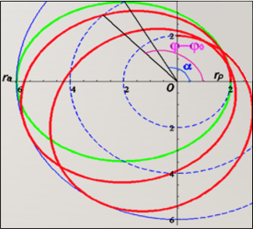

SOLVING FOR TRAJECTORY (CONTINUATION)
Looking for solutions in the form:
$φ\left(φ\right)=μ\left(1+ε\cos{α(φ)}\right)$ (31)
Where $φ_{p}=μ\left(1+ε\right), φ_{a}=μ(1−ε)$(elliptic motion)
$−\left(φ−φ_{p}\right)\left(φ−φ_{a}\right)=μ^{2}ε^{2}\sin^{2}{α\left(φ\right)}$ (32)
$\frac{dφ}{dφ}=μα^{′}⋅ε\sin\left(α\right)$ (33)
$φ_{e}−φ=1−3−με\cos{α\left(φ\right)}$ (34)
Substitute (32)–(34) into eq (28)
$α^{′}=\frac{dα}{dφ}=\sqrt{1−3μ−με\cos{α(φ)}}$ (35)
Precessing ellipse
$φ\left(α\right)=φ_{0}+\int_{0}^{α}{{\left(1−3μ−με\cos{\tilde{α}}\right)}^{−1/2}d\tilde{α}}$ (36)
$∆φ=φ\left(2π\right)−φ_{0}−2π≈3μπ_{\left(\frac{rad}{rev}\right)}$ (37)

Slide 20
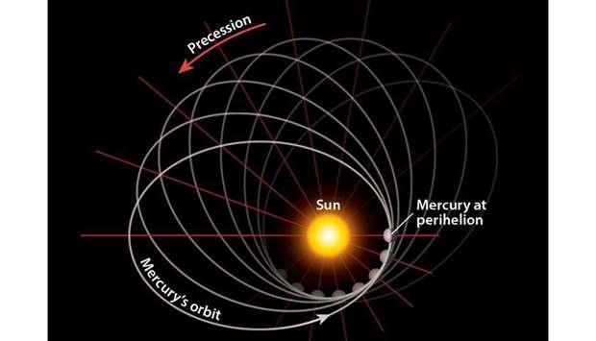

MERCURY’S PRECESSION
$r_{a}=6.98168⋅{10}^{10}m and r_{p}=4.60012⋅{10}^{10}m r_{s}= 2953.25m,$
$φ_{p}=\frac{r_{s}}{r_{p}}=6.41994⋅{10}^{−8}, φ_{a}=\frac{r_{s}}{r_{a}}=4.22999⋅{10}^{−8}$
$μ=\frac{1}{2}\left(φ_{p}+φ_{a}\right)=5.32497⋅{10}^{−8}$
$⟹∆φ=5.01867∙{10}^{−7}$ $radians per revolution$
Calculating the precession over a century (100 years)
$T=88 days , \frac{century}{T}≈415 rev$
$⇒Δφ_{century}=2.08275⋅{10}^{−4} radians=42.96 arcseconds$
Illustration credit: https://www.menafn.com

Slide 21

MOTION OF LIGHT IN A STATIONARY, SPHERICALLY SYMMETRIC GRAVITATIONAL FIELD
$\frac{∂L}{∂t}=0⟹p_{t}$is a constant of motion,
$p_{t}=\left(1−φ\left(r\right)\right)c^{2}\dot{t}−cφ\left(r\right)\dot{r}=const$ (38)
${\left(\frac{p_{t}}{c}\right)}^{2}={ {\left(1−φ\left(r\right)\right)}^{2} c}^{2}{\dot{t}}^{2}−2cφ\left(r\right)\left(1−φ\left(r\right)\right)\dot{t}\dot{r}+φ{\left(r\right)}^{2}{\dot{r}}^{2}=E$ (39)
Four-velocity norm
$u^{2}=0=\left(1−φ\left(r\right)\right)c^{2}{\dot{t}}^{2}−2cφ\left(r\right)\dot{t}\dot{r}−\left(1+φ\left(r\right)\right){\dot{r}}^{2}−r^{2}{\dot{φ}}^{2}$ (40)
${\left(\frac{p_{t}}{c}\right)}^{2}−\left(1−φ\left(r\right)\right)u^{2}={\dot{r}}^{2}+\left(1−φ\left(r\right)\right){r^{2}\dot{φ}}^{2}=E$ (41)
$\frac{∂L}{∂φ}=0$, $⟹p_{φ}$is a constant of motion $p_{φ}= J=r^{2}\dot{φ}$
Light trajectory $r\left(φ\right)$ equation:
${\left(\frac{J}{r^{2}}\frac{dr}{dφ}\right)}^{2}+\left(1−\frac{r_{s}}{r}\right)\frac{J^{2}}{r^{2}}=E$ (42)

Slide 22

DEFLECTION OF LIGHT
At the point on the trajectory $P$closest to the Sun, $\frac{dr}{dφ}\left(P\right)=0$
Thus, from eq. (42) at P, $J^{2}=\frac{Er_{0}^{2}}{1−r_{s}/r_{0}}$ , and the equation becomes
${\left(\frac{r_{0}}{r^{2}}\frac{dr}{dφ}\right)}^{2}+\left(1−\frac{r_{s}}{r}\right)\frac{r_{0}^{2}}{r^{2}}=1−\frac{r_{s}}{r_{0}}$ (43)
Define $r\left(φ\right)=\tilde{r}\left(α\right)=\frac{r_{0}}{\sin{(α)}} ,$
$⇒\frac{dr}{dφ}=−\frac{r_{0}\cos\left(α\right)⋅α^{′}}{\sin^{2}\left(α\right)}=−\frac{r^{2}\cos\left(α\right)⋅α^{′}}{r_{0}}$ (44)
$\cos^{2}{(α)}⋅{\left(α^{′}\right)}^{2}=1−\sin^{2}\left(α\right)−\frac{r_{s}}{r_{0}}\left(1−\sin^{3}{α}\right)$
$⇒{\left(α^{′}\right)}^{2}=1−\frac{r_{s}}{r_{0}}\left(\frac{1−\sin^{3}{α}}{1−\sin^{2}{α}}\right)=1−\frac{r_{s}}{r_{0}}\left(\sin{α}+\frac{1}{1+\sin{α}}\right)$ (45)
$\frac{dφ}{dα}={\left(1−\frac{r_{s}}{r_{0}}\left(\sin{α}+\frac{1}{1+\sin{α}}\right)\right)}^{−1/2}≈1+\frac{r_{s}}{{2r}_{0}}\left(\sin{α}+\frac{1}{1+\sin{α}}\right)$ (46)
If $r≫r_{0}$
$∆φ=\int_{0}^{π}{1+\frac{r_{s}}{{2r}_{0}}\left(\sin{α}+\frac{1}{1+\sin{α}}\right)}dα−π=\frac{2r_{s}}{r_{0}}=\frac{4GM}{c^{2}r_{0}}$ (47)

Slide 23
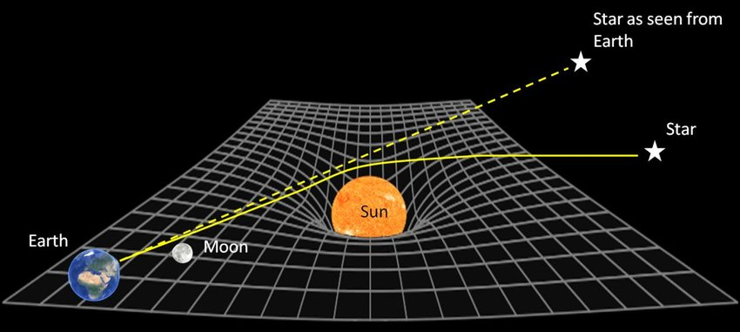
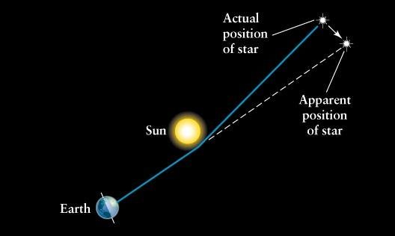
DEFLECTION OF LIGHT
(CONTINUATION)

Slide 24

GRAVITATIONAL TIME DILATION
Line element
$ds^{2}=\left(1−φ\left(r\right)\right)c^{2}dt^{2}−2cφ\left(r\right)dtdr−\left(1+φ\left(r\right)\right)dr^{2}−r^{2}dφ^{2}$ (48)
Clock at rest $dr=dφ=0$
$⇒c^{2}dτ^{2}=ds^{2}=\left(1−φ\left(r\right)\right)c^{2}dt^{2}$ (49)
$dτ$-time increment on the clock
$⇒dτ=\sqrt{1−φ\left(r\right)}dt$ (gravitational time dilation) (50)
For a moving clock
$β_{r}=\frac{dr}{cdt} \left(52\right), β_{tr}=\frac{r}{c}⋅\frac{dφ}{dt} \left(53\right)$
$$β^{2}=β_{r}^{2}+β_{tr}^{2}$$
$c^{2}dτ^{2}=c^{2}dt^{2}\left(1−φ\left(r\right)−2φ\left(r\right)β_{r}−\left(1+φ\left(r\right)\right)β_{r}^{2} −β_{tr}^{2}\right)=c^{2}dt^{2}\left(1−β^{2}−φ\left(r\right){\left(1+β_{r}\right)}^{2}\right)$ (51)
Time dilation of a moving clock
$dt=\frac{1}{\sqrt{1−β^{2}−φ\left(r\right){\left(1+β_{r}\right)}^{2}}}dτ$ (54)

Slide 25

ENERGY CONSERVATION
Denote $v_{tr}≡r\dot{φ}$, then:
$\frac{m}{2}⋅\left(23\right)=\frac{m\left({\dot{r}}^{2}+v_{tr}^{2}\right)}{2}+U\left(r\right)+U\left(r\right)\frac{v_{tr}^{2}}{c^{2}}=const$ (55)
$$U\left(r\right)=φ\left(r\right)⋅c^{2}$$
Energy conservation
$E=\frac{mv^{2}}{2}+U\left(r\right)+U\left(r\right)\frac{v_{tr}^{2}}{c^{2}}$ (56)
The last term does not appear in the classical equation
Classical ${\dot{r}}^{2}+\frac{J^{2}}{r^{2}}−c^{2}φ\left(r\right)=\tilde{E}$ (57.1)
Relativity ${\dot{r}}^{2}+\frac{J^{2}}{r^{2}}\left(1−φ\left(r\right)\right)−c^{2}φ\left(r\right)=\tilde{E}$ (57.2)
Classical ${\left(\frac{dr}{dt}\right)}^{2}+{\left(\frac{dr_{t}}{dt}\right)}^{2}−c^{2}φ\left(r\right)=\tilde{E}$ (58.1)
Relativity ${\left(\frac{dr}{dτ}\right)}^{2}+{\left(\frac{dr_{t}}{dt}\right)}^{2}−c^{2}φ\left(r\right)=\tilde{E}$ (58.2)

Slide 26

APPENDIX

Slide 27
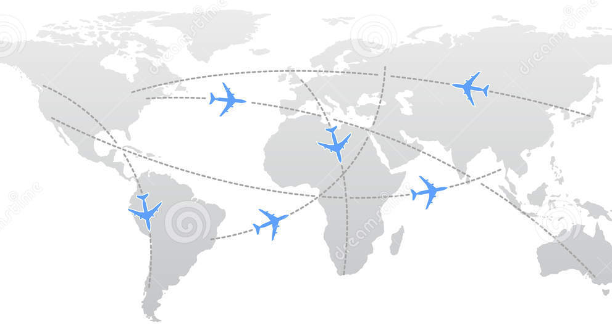
GEODESIC MOTION ON THE GLOBE
Geodesic - The shortest path between two points in curved space time.
If the distance between two close points is defined by a metric, then the distance of the path is defined by integrating the metric.
Retarded time – the radiation emitted at the retarded time is observed now by the observer.
Airplane route
Constant velocity
Map and metric - the way of translating space increments from the map to the corresponding increments in space

Slide 28

LOCAL BASIS IN BIPOLAR COORDINATES
$\dim{M}=4,$ $4=2+2$ Decompose:
$$M=M_{0}+M_{1}$$
$$M_{0}=Π\left(e_{0}, e_{3}\right) M_{1}=Π\left(e_{1}, e_{2}\right)$$
Bipolar (BP) coordinates $(ρ^{0}, ρ^{1}, φ, θ)$, for $r∈M$
$$r^{0}=ρ^{0}\cosh{θ}, { r}^{1}=ρ^{1}cosφ, { r}^{2}=ρ^{1} sinφ, { r}^{3}=ρ^{0}sinh⁡θ$$
$$−∞<ρ^{0}<∞, 0≤ρ^{1}, 0≤ φ≤2π, −∞<θ<∞$$
Polar coordinates in $M_{1}$ and hyperbolic coordinates in $M_{0}$
Norm ${\left(r\right)}^{2}={\left(ρ^{0}\right)}^{2}−{\left(ρ^{1}\right)}^{2}$
Light cone $ρ^{0}$=$ρ^{1}$ - hyperplane
${\left(r\right)}^{2}=0,$ $r=ρ(cosh{θ}, cosφ, sinφ, sinh⁡θ)$

Slide 29

LOCAL BASIS IN BIPOLAR COORDINATES
(CONTINUATION)
Local basis at point $P$with respect to some coordinate system consists of partial derivatives at $P$ of the position vector with respect to each coordinate.
Local basis for bipolar coordinates:
$$d_{0}=\frac{∂r}{∂ρ^{0}}=\left(\cosh{θ,0,0,\sinh{θ}}\right)$$
$d_{1}=\frac{∂r}{∂ρ^{1}}=\left(0,\cos{φ,\sin{φ,0}}\right)$
$$d_{2}=\frac{1}{ρ^{1}}\frac{∂r}{∂φ}=\left(0,\sin{φ,−\cos{φ,0}} \right)$$
$$d_{3}=\frac{1}{ρ^{0}}\frac{∂r}{∂θ}=\left(\sinh{θ,0,0,}cosh{θ}\right)$$
This basis is orthonormal and depends only on the angles
Non-zero derivatives of the basis vectors:
$$d_{0,θ}=d_{3}, d_{3,θ}=d_{0}, d_{1,φ}=d_{2}, d_{2,φ}=−d_{1}, d_{j, ρ^{0}}=d_{j, ρ^{1}}=0$$
If $r$ is null, then $r=ρ(d_{0}+d_{1})$

Slide 30
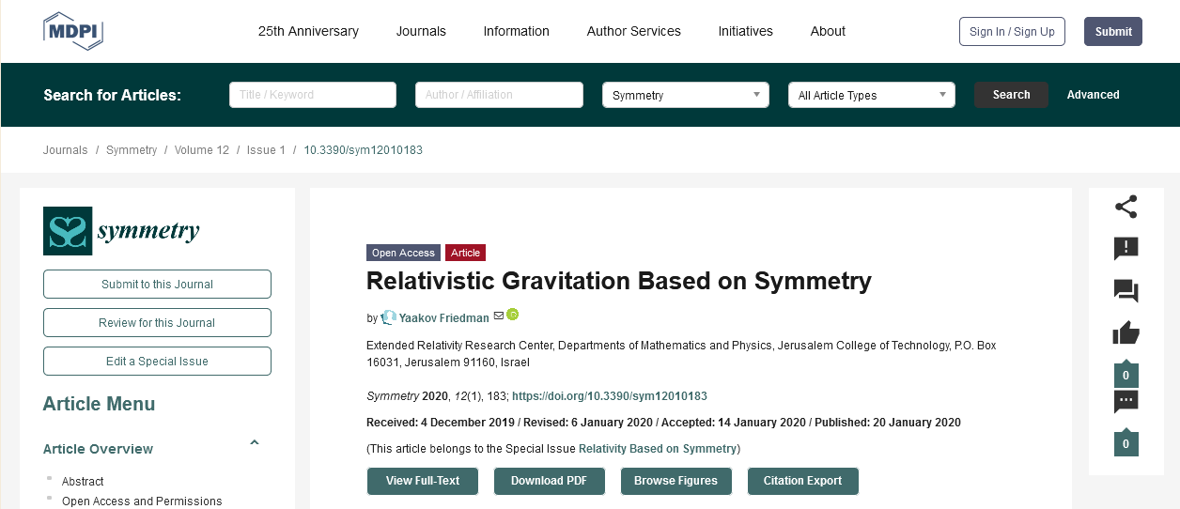
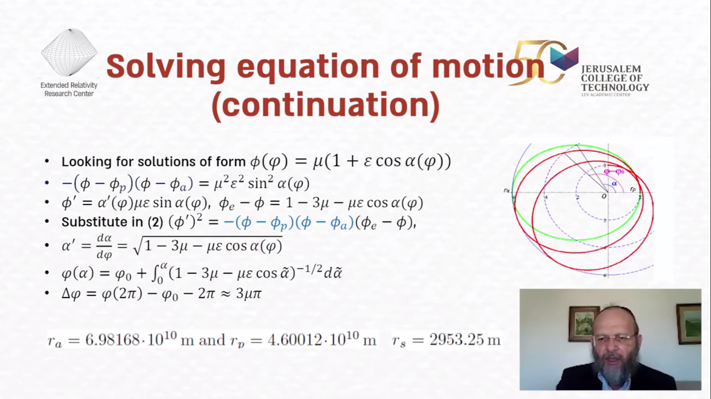
Click here to watch the lecture on YouTube
⇒
⇒
Click here to read the full article on MDPI
For any questions and more information, please contact Prof. Friedman at friedman@g.jct.ac.il

